Slide 1
Java FileReader class
myfile.txt
Java Application
Read
Peter is going to India
Java FileReader class is used to read data from text files.
FileReader is meant for reading streams of characters. For reading streams of raw bytes, consider using a FileInputStream.

Slide 2
Java FileReader class
Reader
InputStreamReader
FileReader

Slide 3
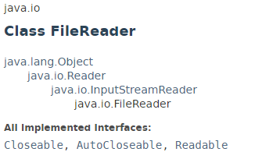
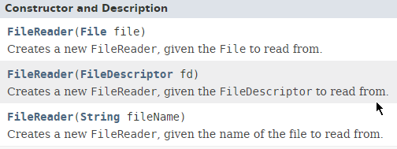
Java FileReader class

Slide 4

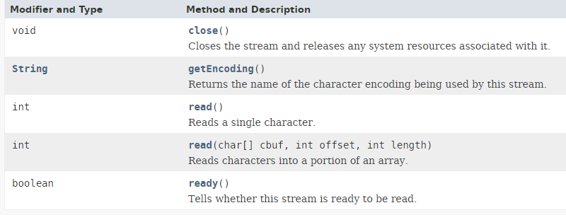
Java FileReader class

Slide 5

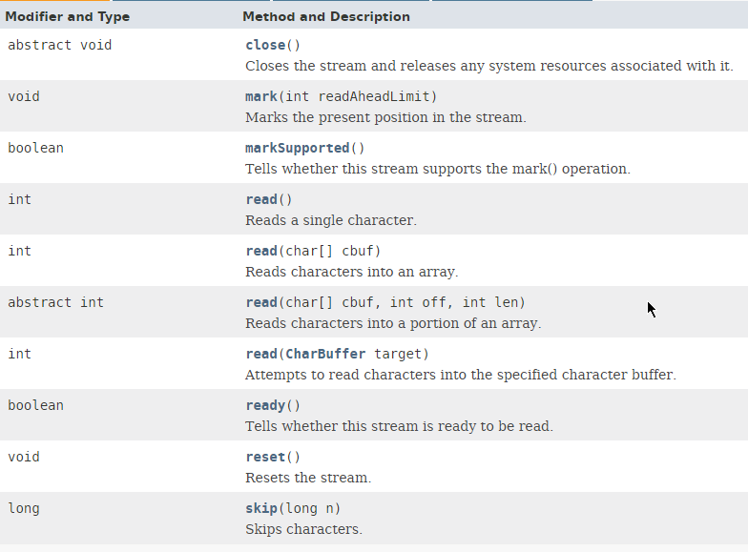
Java FileReader class

Slide 6
Java FileReader class
https://docs.oracle.com/javase/8/docs/api/index.html?java/io/FileReader.html

